Slide 1


Paucek & Lage
Home
About Us
Project
Contact
WALKIE
TALKIE
PRESENTATION
Start Slide

Slide 2

Paucek & Lage
Home
About Us
Project
Contact
Project Supervision
& Team Members
Supervised by:
  Dr. Wafaa Hany
Project Team Members
  Mahmoud Ashry
  Sohaila Abdelnasser
  Fatma El Zahraa Mohamed
Teaching Assistants:
  Eng. George
  Eng. Esraa
  Jumana Hazem
  Aliaa Hesham
Next Slide

Slide 3


Paucek & Lage
Home
About Us
Project
Contact
Operating systems play a critical role in managing system resources and enabling communication between processes. One of the most important responsibilities of an operating system is providing mechanisms for inter-process communication (IPC), process synchronization, and multithreading, which are essential for building concurrent and distributed applications.
The main objective of this project is to design and implement two chat systems that allow users to exchange messages in real time using different operating system techniques. Each system demonstrates a distinct communication approach supported by modern operating systems.
The first chat system is implemented using network sockets and multithreading, allowing users to communicate across different machines through a network. This system follows a client-server architecture and utilizes threads to handle multiple clients concurrently.
Project
Introduction
Next Slide

Slide 4
Paucek & Lage
Home
About Us
Project
Contact
The second chat system is implemented using shared memory and synchronization mechanisms, where users communicate on the same machine. Shared memory is used as a fast inter-process communication method, while synchronization techniques such as semaphores or mutexes are applied to prevent race conditions and ensure data consistency.
Through this project, several core operating system concepts are applied in practice, including multithreading, inter-process communication, critical section management, and synchronization. The project provides hands-on experience in understanding how operating systems support concurrent applications and communication between processes.
Project
Introduction
Next Slide

Slide 5
Paucek & Lage
Home
About Us
Project
Contact
This project consists of two independent chat systems, each implemented using a different communication mechanism supported by the operating system. Both systems aim to allow users to exchange messages in real time while demonstrating key operating system concepts such as concurrency, inter-process communication, and synchronization.
The two systems are implemented using the C/C++ programming language on the Microsoft Windows operating system, and both include a simple graphical user interface (GUI) developed using WinAPI.
System
overview
Next Slide

Slide 6
Paucek & Lage
Home
About Us
Project
Contact
Each system targets a specific communication scenario:
The first system enables communication between users on different machines using network sockets and multithreading.
The second system enables communication between users on the same machine using shared memory and synchronization mechanisms.
These two approaches highlight the differences between distributed communication and local inter-process communication, as well as their advantages and limitations.
System
overview
Next Slide

Slide 7
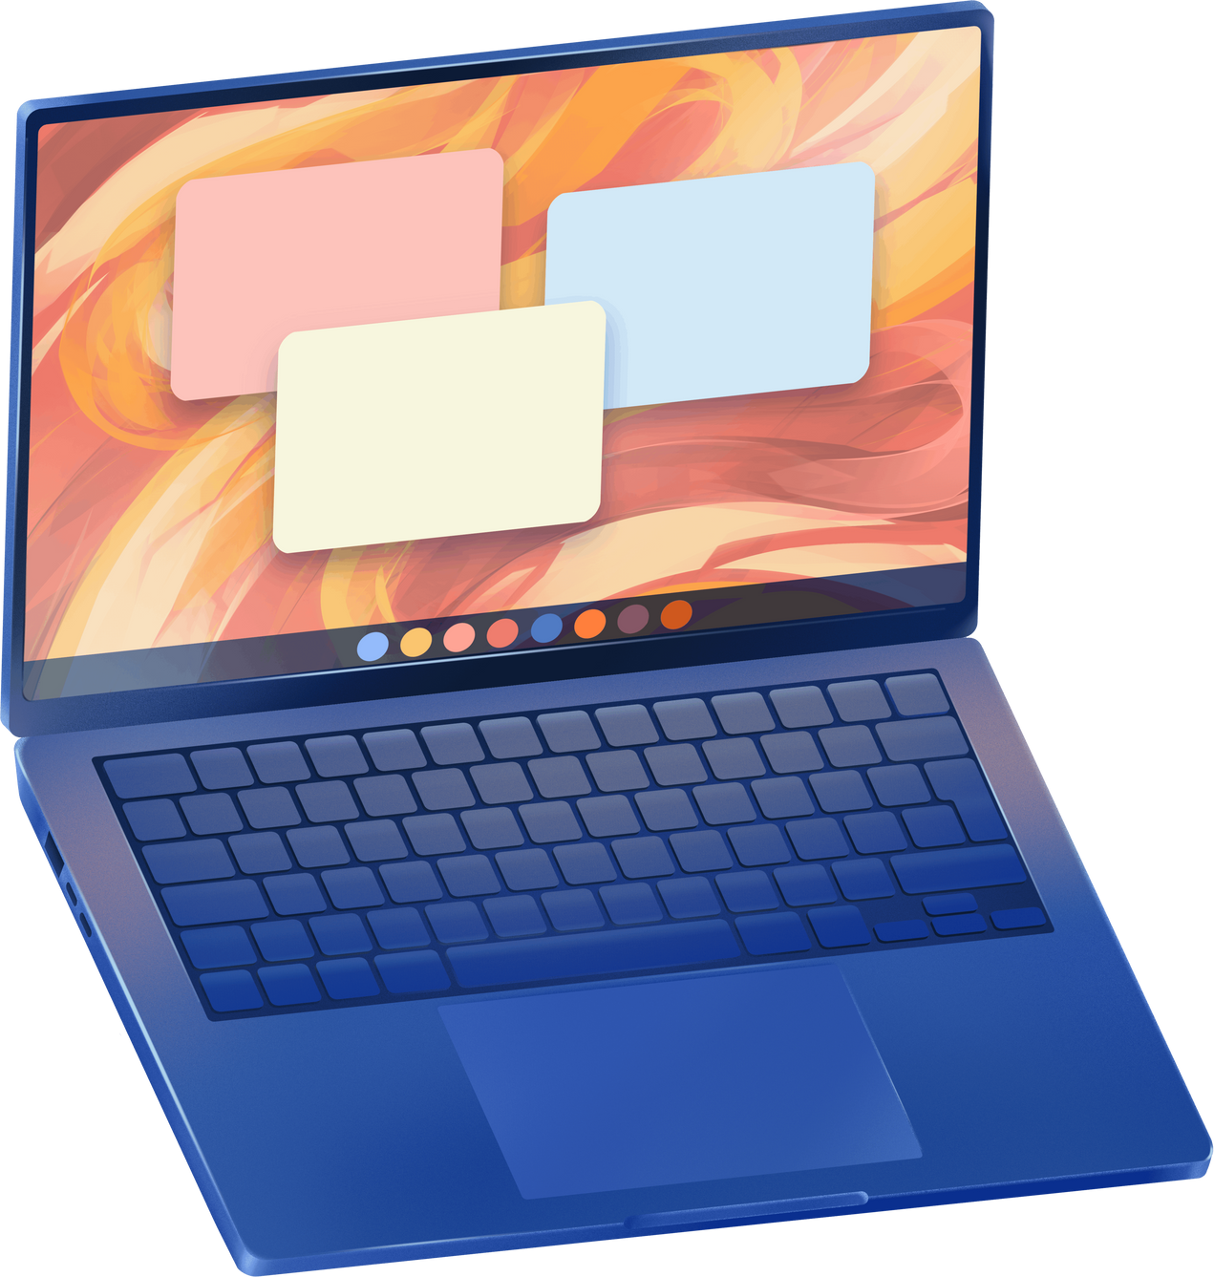
Paucek & Lage
Home
About Us
Project
Contact
Chat System Using Sockets
& Multithreading
The first chat system is based on a client-server architecture using TCP sockets. In this system, a central server is responsible for managing connections and forwarding messages between connected clients.
Each client runs on a separate machine or the same machine and connects to the server through a network. The server uses multithreading to handle multiple clients concurrently, where each connected client is served by a dedicated thread. This design allows the server to process messages from different clients simultaneously without blocking other connections
Next Slide

Slide 8

Paucek & Lage
Home
About Us
Project
Contact
Chat System Using Sockets
& Multithreading
The use of sockets enables communication over a network, making this system suitable for distributed environments. Multithreading ensures responsiveness and scalability, as multiple clients can send and receive messages at the same time.
Key Operating System Concepts Used:
Concurrent client handling
Client-server communication model
Multithreading
Next Slide
Network sockets

Slide 9

Paucek & Lage
Home
About Us
Project
Contact
The second chat system is designed for communication between users running on the same machine. This system uses shared memory as an inter-process communication mechanism, allowing multiple processes to access a common memory region.
To ensure correct and safe access to the shared memory, semaphores are used as synchronization primitives. Semaphores prevent race conditions by controlling access to critical sections where shared data is read or written. This guarantees data consistency and avoids conflicts between concurrent processes.
Chat System Using Shared Memory
& Synchronization
Next Slide

Slide 10

Paucek & Lage
Home
About Us
Project
Contact
Chat System Using Shared Memory
& Synchronization
Unlike socket-based communication, shared memory provides high-speed communication because data does not need to be transferred through the network stack. However, this approach is limited to processes running on the same operating system instance.
Key Operating System Concepts Used:
Shared memory
Critical section protection
Semaphores
Next Slide
Synchronization

Slide 11
Paucek & Lage
Home
About Us
Project
Contact
Thank
You!
End Slide

